Slide 1

Tech Invent 2024
Conversational Image Recognition Chatbot
Problem Statement: Conversational Image Recognition Chatbot
PS Category- Software
Team Name: SpacePetrolDelta
College name: Chandigarh University

Slide 2
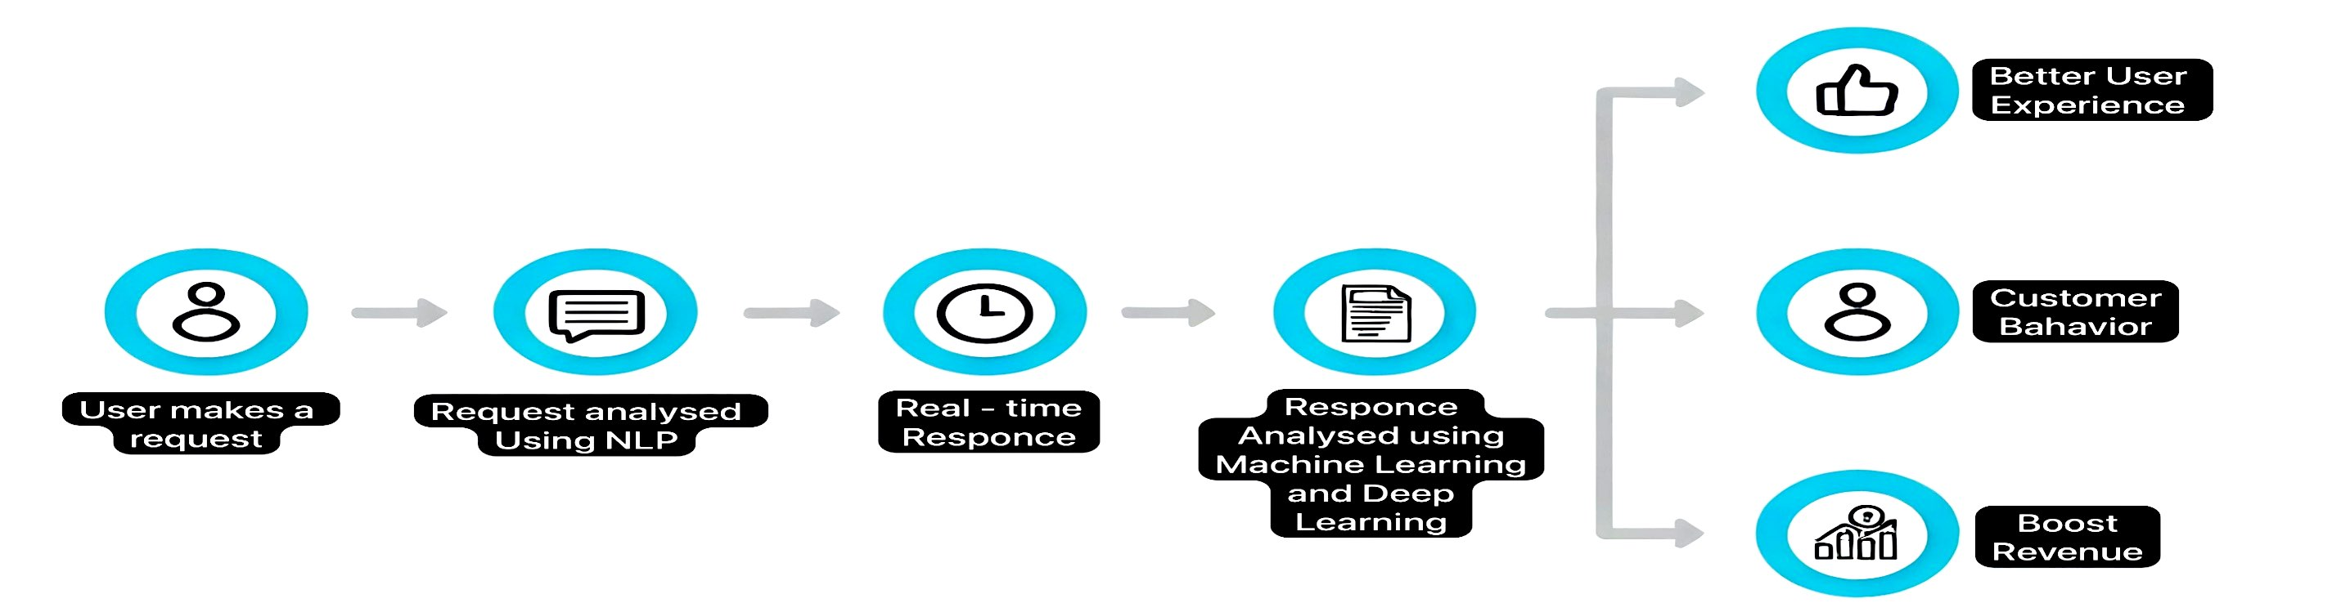
Visual Chatbot
SpacePetrolDelta
Detailed Explanation: The chatbot uses image recognition and natural language processing to analyze images and provide intelligent conversational responses.
How It Addresses the Problem: It simplifies user interaction by enabling seamless conversations about visual content without needing specialized knowledge.
Innovation and Uniqueness: The unique combination of conversational AI and real-time image recognition creates a versatile multi-modal interface for users.

Slide 3
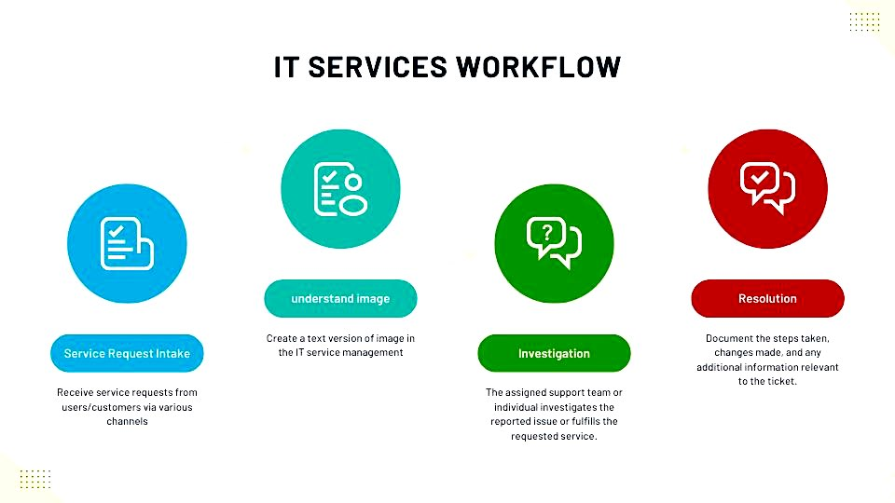






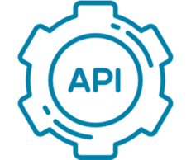
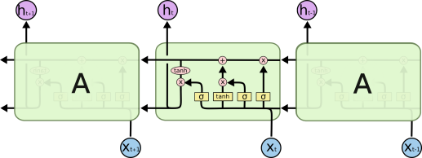
TECHNICAL APPROACH
SpacePetrolDelta
Technologies to be used:
Programming languages: HTML, CSS, JavaScript, BootStrap, Python.
Frameworks and Libraries: TensorFlow/keras, pytorch, flask/Django, self-Attention, React.js.
Databases: MongoDB.
Machine Learning Models: Mask R-CNN , LSTM.
APIs and Integrations – Cloudinary , RESTful APIs.

Slide 4
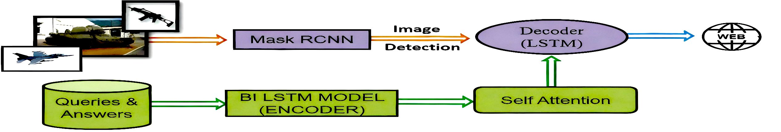
FEASIBILITY AND VIABILITY
SpacePetrolDelta
Analysis of the Feasibility of the Idea:
Availability of Technology: Existing frameworks (TensorFlow, PyTorch, Rasa) make implementation technically feasible.
Scalability: Cloud infrastructure (AWS, Google Cloud) allows scalable deployment with minimal overhead.
Potential Challenges and Risks:
Real-Time Data Processing: Managing large volumes of real-time image and text data could strain resources.
Accuracy Issues: Ensuring consistent image recognition and natural language understanding across varied contexts.
Strategies for Overcoming These Challenges:
optimized Infrastructure: Use cloud solutions like serverless architectures to handle traffic spikes efficiently.
Continuous Model Training: Regular updates to the AI models to enhance accuracy and adapt to new data.
User Experience:
Error Handling: Implement clear feedback loops for user errors or misunderstood inputs to maintain engagement.

Slide 5
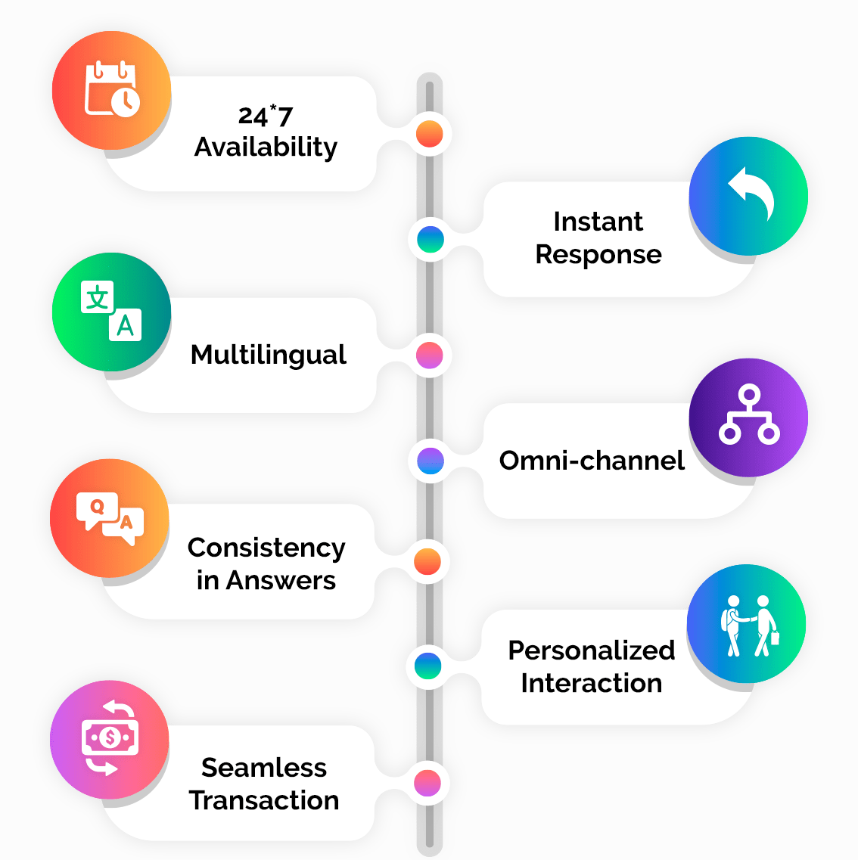
IMPACT AND BENEFITS
SpacePetrolDelta
Social Awareness and Empowerment:
Use Case: A non-profit organization uses the chatbot to educate the community about health and wellness topics.
Solution: Users can submit images related to health concerns (e.g., food items) and receive feedback on nutrition and wellness.
Benefit: This raises awareness about health issues and empowers individuals to make informed choices about their well-being.
Impact on User Engagement:
Use Case: A medical professional uses the chatbot to analyze patient images for identifying abnormalities.
Solution: The chatbot analyzes X-rays, MRIs, or CT scans, recognizing patterns and providing diagnostic suggestions along with relevant medical history.
Benefit: This improves healthcare efficiency and decision-making, encourages accurate diagnoses, and enhances patient care.

Slide 6
RESEARCH AND REFERENCES
SpacePetrolDelta
Research Papers and Articles
Vaswani, A., et al. Attention Is All You Need: [https://arxiv.org/abs/1706.03762]
He, K., et al. Mask R-CNN: [https://arxiv.org/abs/1703.06870]
Smith, J., The Evolution of Conversational AI. Journal of Artificial Intelligence, 2019.
Web Resources
TensorFlow Documentation: [https://www.tensorflow.org]
PyTorch Documentation: [https://pytorch.org/]
MongoDB Database Documentation: [https://www.mongodb.com/]
Books and Additional References
Chollet, F. Deep Learning with Python, 2nd Edition. Manning Publications, 2021. [https://www.manning.com/books/deep-learning-with-python]
Goodfellow, I., Bengio, Y., & Courville, A. Deep Learning. MIT Press, 2016. [https://www.deeplearningbook.org/]

